Slide 1
Internet marketing

Slide 2
Get the slides and other material
www.ilkkakauppinen.com/mojaafrica

Slide 3
Program
Basics of the marketing
Basics of the internet marketing
Speed of site
SEO a.k.a. Search Engine Optimatisation
Building a trust
Pricing
Social media
Email marketing
Internet selling
Traditional marketing
Selling to travel agencies, work shops

Slide 4
Today
What is internet marketing
Tools
Home work

Slide 5
Homework
Website, please send Ilkka screen shots
Google Analytics, instal and more info https://marketingplatform.google.com/about/analytics/ Please notice that it’s a very complex program, but in the beginning we just need the basic functions. If you are unable to install it it, please contact me. It is a free program.

Slide 6
What is internet marketing?

Slide 7
Notes:
Hiiripyramidin rakentaminen on paljon helpompaa pala palalta kuin yhden ison norsun.
Internet-markkinoinnin kehittäminen kannattaa laittaa kuntoon pala kerrallaan. Näin säilyy joustavuus ja homma eteneen.

Slide 8
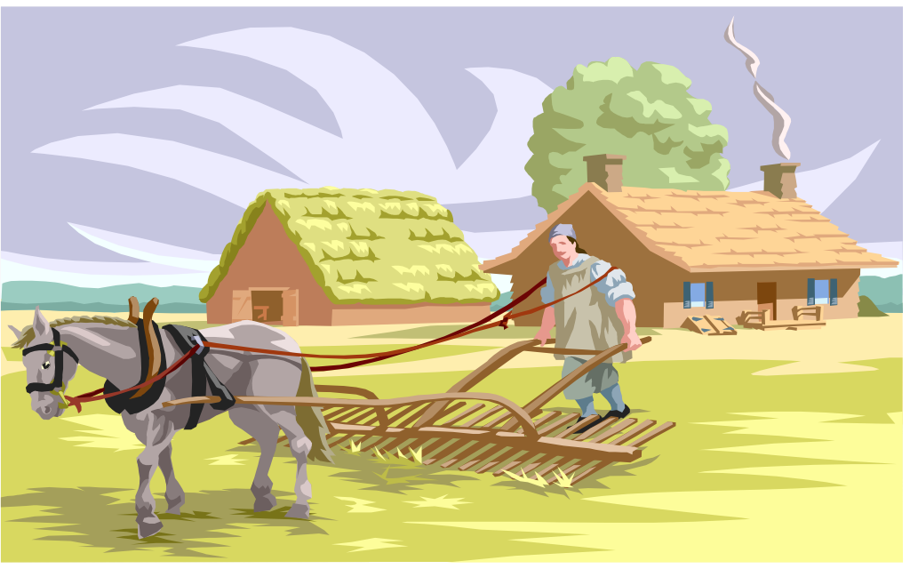

Slide 9
My trip to Estonia

Slide 10
All the time
Before
During
After

Slide 11
What ever you do, do it properly!

Slide 12
Your website?
Wordpress
Google Analytics?
Google Search Console
Need help?

Slide 13
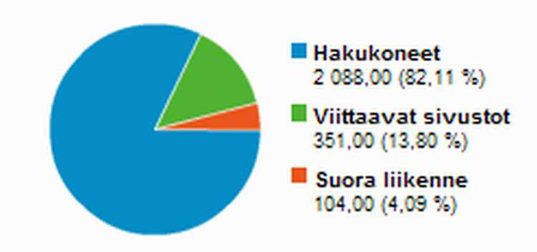

Slide 14
Tools
Website
SEO
Internet advertising
Email marketing
Social media, Youtube

Slide 15
SEO
Content
Links
People behavior on your site - Google Analytics
Meta info
Tricks

Slide 16
SEO friendly content
To your target group
Safari in Africa
Use the keywords a lot
Long enough
Titles and subtitles
Tricks like meta info

Slide 17
Internet advertising
Meta
Google
Remarketing is most powerful
Need money for this. Cheaper from Tanzania.

Slide 18
Meta and google Pixels
Need to install these for remarketing!
Easy but better do it early

Slide 19
Videos and photos
Youtube
Other channels like social media
If you like making videos, let’s do it!

Slide 20
Next meeting?
Next Tuesday same time 10-12 Finnish. Ilkka will send the meeting link on Monday.

Slide 21
Homework
Send Ilkka address to login, username and password of your website.
Ask if your clients use TikTok.

